Slide 1
Summer Internship
NAME – Kunal SACHDEVA
Roll No: - 19115045
Branch:7TH SEMESTER cse

Slide 2
Overview/Roadmap
Completed a course offered by Johns Hopkins University on HTML, CSS, and JavaScript for Web Developers.
Completed various assignments for the course.
Learned ReactJS through its documentation.
Built an Expense Tracker application using ReactJS.
Built a clone of the famous Amazon E-commerce website using ReactJS.
Learned firebase through various sources.
Implemented login page and login functionality on the amazon clone using firebase and deployed the website using firebase.

Slide 3



Slide 4
Project Description
Expense Tracker
It is an expense tracker application using ReactJS.
Users can add income and expenses as transactions.
It shows total income and expenses and the remaining balance after computing all the transactions.
It uses React hooks to maintain global context.

Slide 5
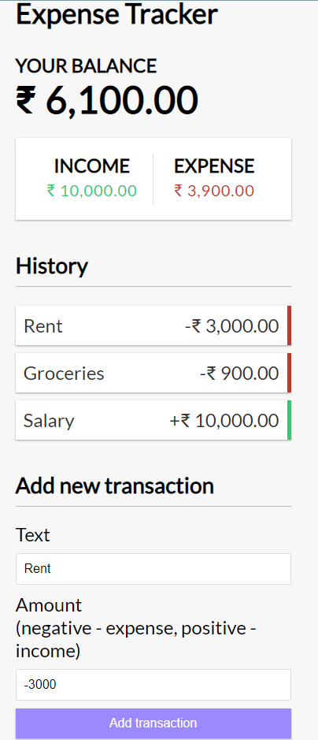
Implementation
This website was built with the help of React library.
Converted basic components of website to ReactJS.
Used React hooks such as useState and useContext.

Slide 6
Project Description
Amazon Clone
It is an e-commerce website used for purchasing variety of products.
Users have the functionality of login and signup
Users can add and remove products from their Cart according to their needs.
Authentication is maintained using Firebase.
It uses to react Hooks for maintaining cart .

Slide 7
Implementation
Using React hooks to maintain global context of cart.
Implemented a cart page that shows all the products added and also has the feature to edit/remove products from basket.
Used firebase for user login and signup.
Implemented a login/signup page.

Slide 8
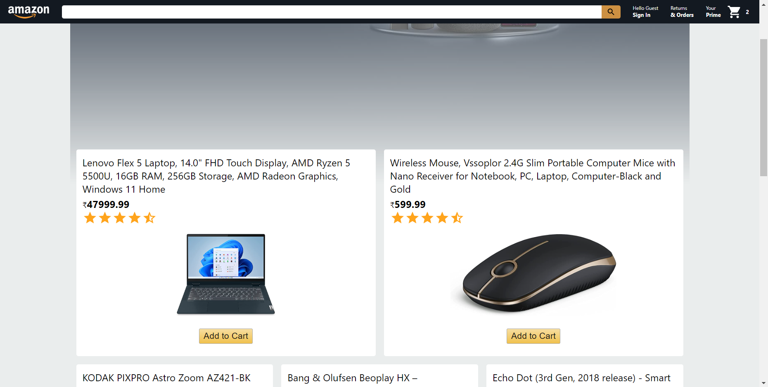
Interface
Home Page
Header has various routing pages.
Header shows the user info.
Header also has the basket info and shows total number of products in cart.
Home page shows details of the product and has an add to cart button.
Add to cart button adds products to cart and updates the basket info.

Slide 9
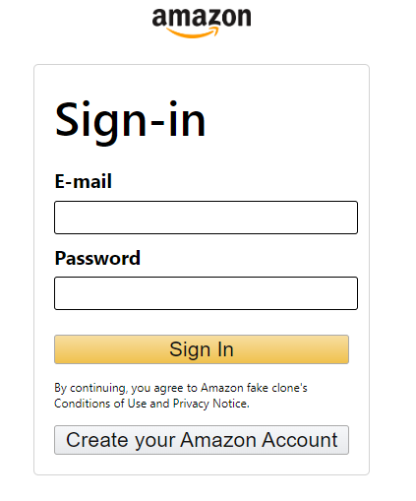
Interface
Login/Signup
Firebase is used to save login credentials and authenticate.
If E-mail/password don’t match it throws a popup saying the same.
On successful login/signup it redirects to home page.

Slide 10
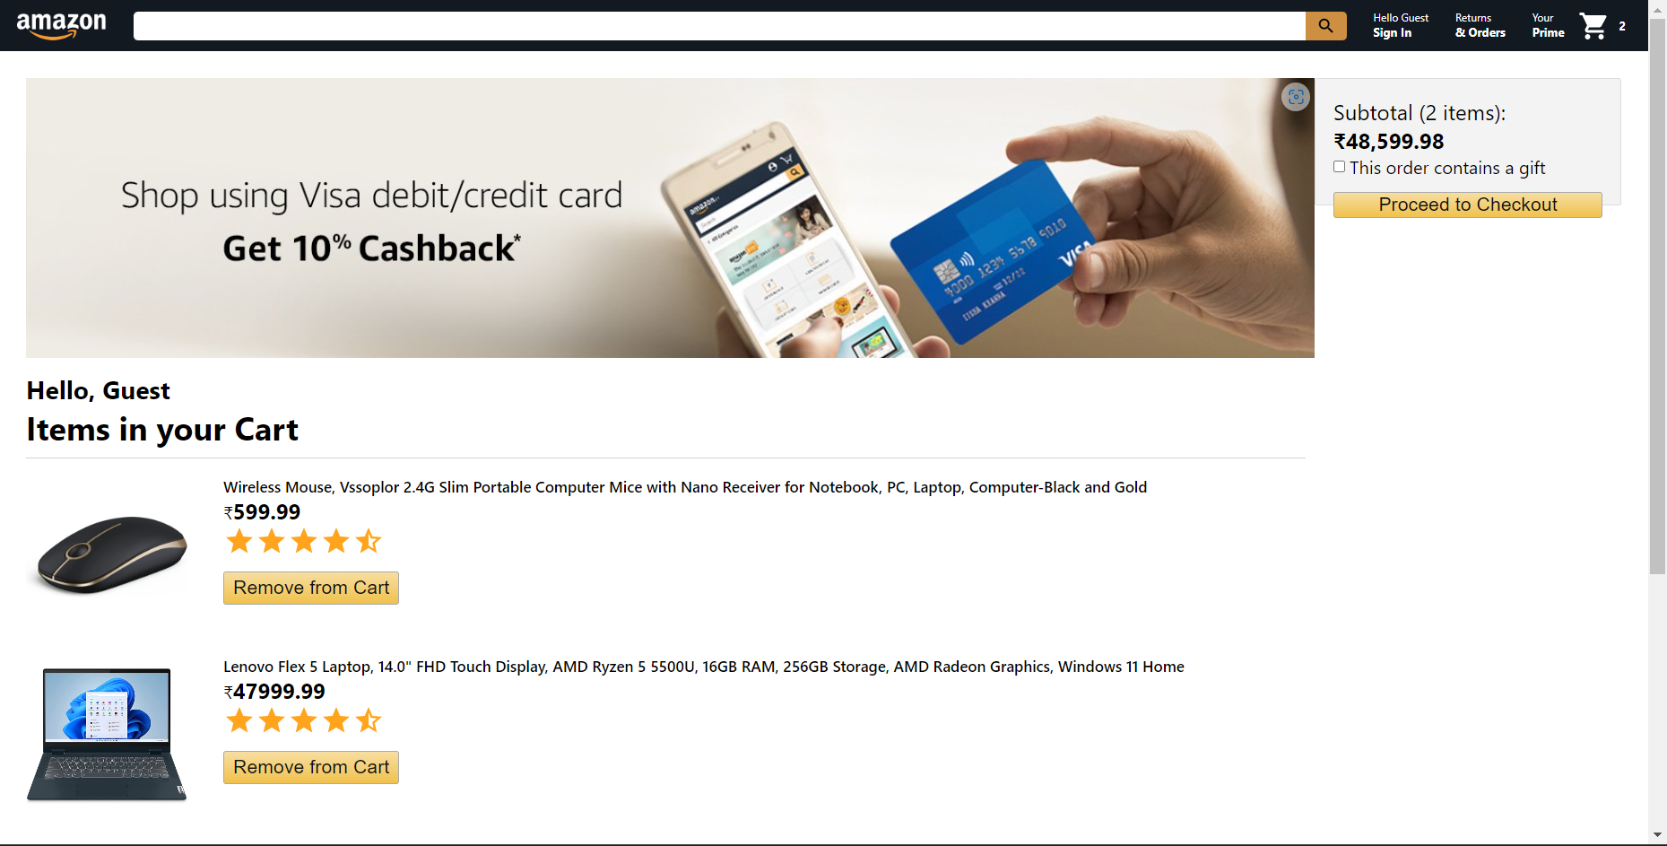
Interface
Cart
Has edit/remove from cart feature.
Shows subtotal from all the carts.
Header has routing features to various components of the site.

Slide 11
Learnings
HTML, CSS
ReactJS
Firebase
JavaScript

Slide 12
THANK YOU

